Slide 1
CHANDIDAS MAHAVIDYALAYA
DEPARTMENT OF GEOGRAPHY
TOPIC:- AGRICULTURE RESOURCE OF INDIA
Prof.- Indrajit Mandal

Slide 2
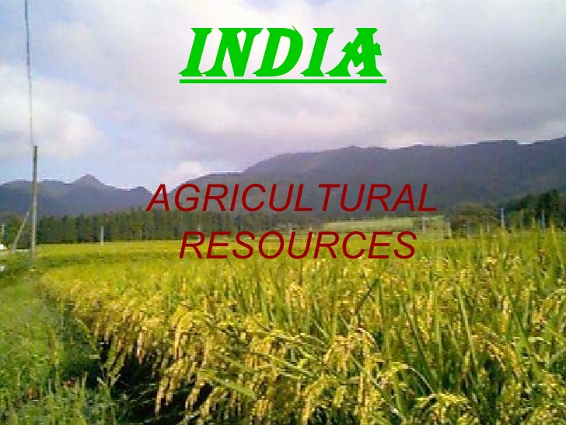

Slide 4
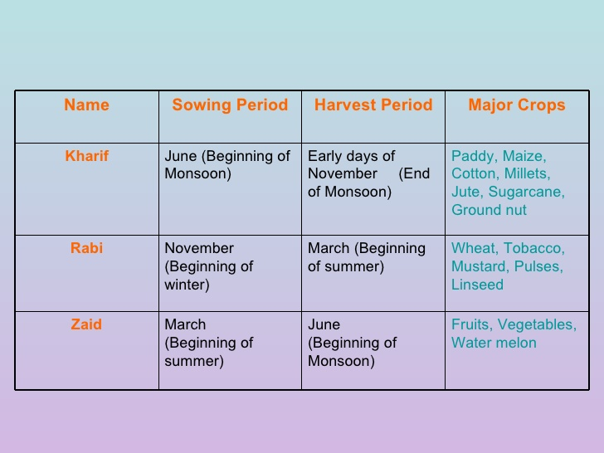

Slide 5
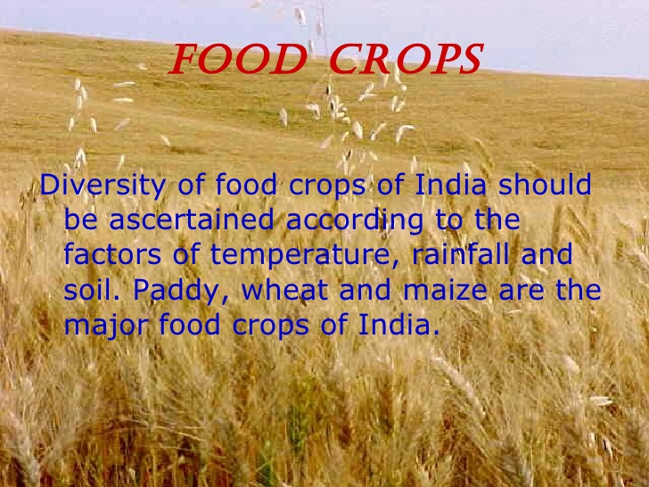

Slide 6
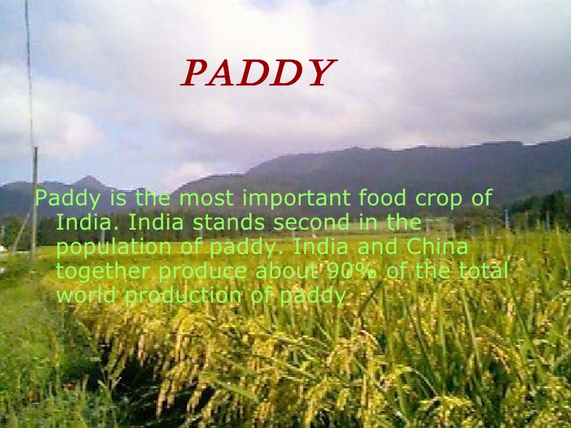

Slide 10
